Slide 1

CEF440
INTERNET PROGRAMMING AND
MOBILE PROGRAMMING
NetInsight
DATABASE DESIGN &
IMPLEMENTATION
Task 6 · Group 16
Submitted to: Dr. Nkemeni Valery

Slide 2
Presentation Overview
01
Project Introduction
05
Database Implementation
02
Data Elements
06
Backend API
03
Conceptual Design
07
DB ↔ Backend Connection
04
ER Diagram
08
Frontend Integration

Slide 3
INTRODUCTION
What is NetInsight?
Frontend
NetInsight is a mobile application built with React Native (Expo) that anonymously collects and analyses mobile network Quality of Experience (QoE) data across Buea, Cameroon.
React Native (Expo)
Backend
Node.js + Express.js 5
Metrics Collected
Download Speed
Geographic Location
Database
MongoDB Atlas (Cloud)
Upload Speed
Signal Strength
Hosting
Latency (RTT)
Connection Type
Railway
ODM
Mongoose 8

Slide 4
Data Elements - Network Metric Data Elements
Field | Type | Description
deviceId | String | Unique device identifier
timestamp | Date | ISO 8601 measurement time
connectionType | String | wifi / cellular / ethernet / unknown
downloadSpeed | Number (Mbps) | Measured download throughput
uploadSpeed | Number (Mbps) | Measured upload throughput
latency | Number (ms) | Round-trip time to google.com
signalStrength | Number (dBm) | Radio signal strength
location | Embedded Doc | latitude, longitude, accuracy

Slide 5
User Feedback Data Elements
Field | Type | Description
experience | String (Enum) | very_poor / poor / fair / good / excellent
areaOfFeedback | String | data_speed, signal_strength, call_quality, etc.
description | String | Free-text user description (optional)
rating | Number (1–5) | Numeric star rating
location | Embedded Doc | latitude & longitude of reported area
networkProvider | String | Mobile network provider (default: Anonymous)
resolved | Boolean | Admin flag – feedback actioned or not
createdAt / updatedAt | Date | Auto-managed timestamps by Mongoose

Slide 6
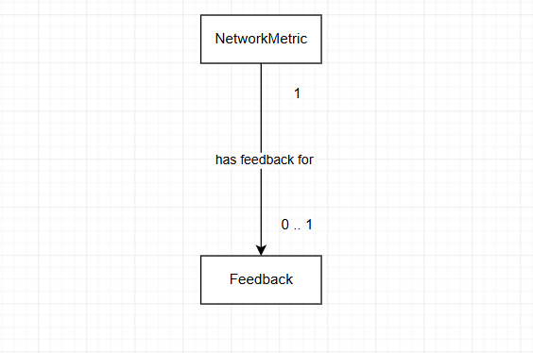
Conceptual Design – Entities & Relationships
A conceptual diagram visually illustrates the relationships between key concepts, ideas, or data entities within a system.
For our application, we identify 2 data entities: Feedback Entity and the NetworkMetric Entity.

Slide 7
ER Diagram – Entities, Attributes & Relationships
NetworkMetric Entity
Feedback Entity
deviceId (identifier)
experience (enum)
timestamp, connectionType
areaOfFeedback, description
rating (1–5)
isConnected, isInternetReachable
location (latitude, longitude)
signalStrength, downloadSpeed
networkProvider
uploadSpeed, latency
resolved (admin flag)
location (latitude, longitude, accuracy)
createdAt, updatedAt
createdAt, updatedAt

Slide 8
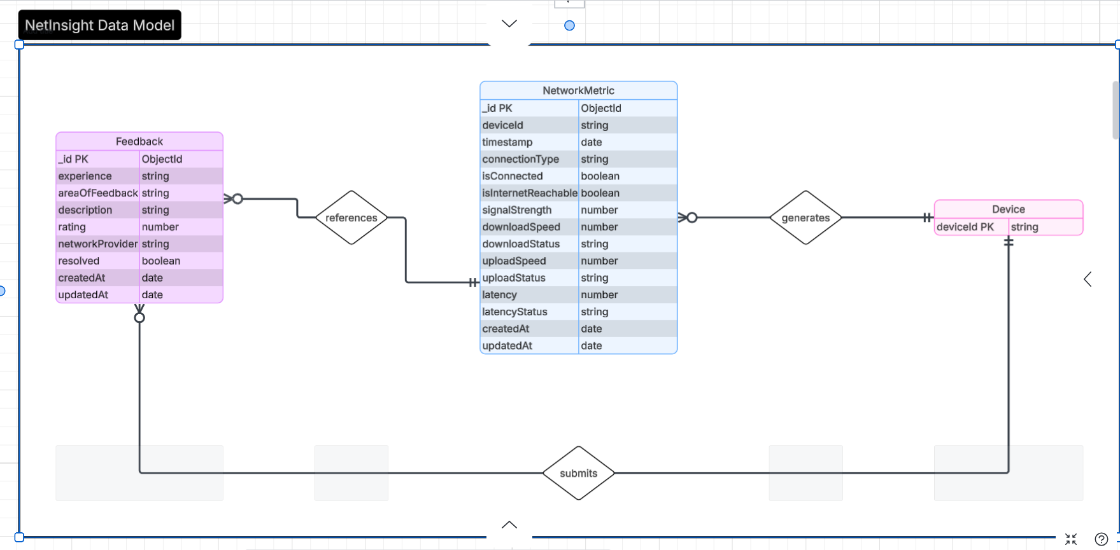

Slide 9
Database Implementation - Why MongoDB Atlas?
Schema Flexibility
Embedded Documents
Metric payloads evolve over time. MongoDB's document model accommodates new fields without costly migrations.
Location sub-objects fit naturally as nested documents, avoiding JOIN operations required by relational databases.
Geospatial Capability
Horizontal Scalability
Native geospatial index support enables future area-based metric queries across Buea.
Atlas scales to handle high write throughput from many devices continuously submitting measurement samples.

Slide 10
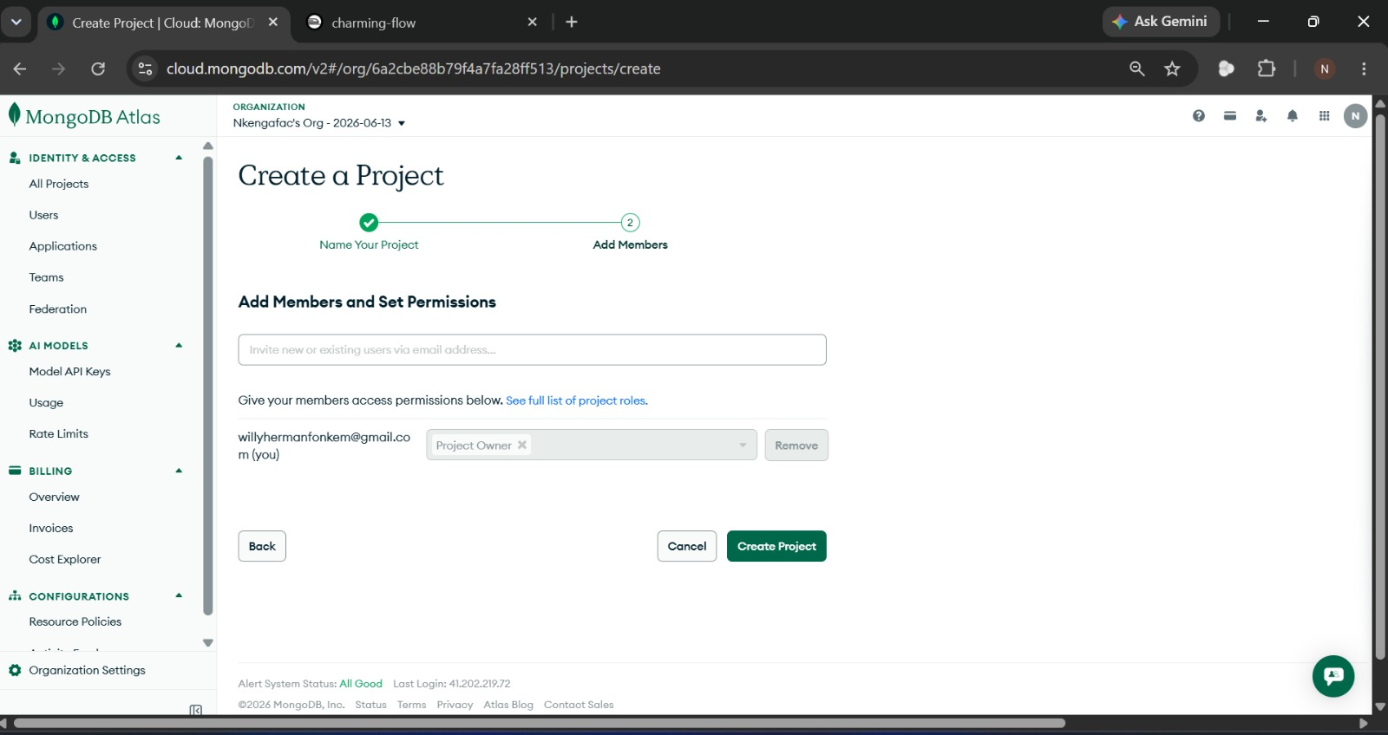
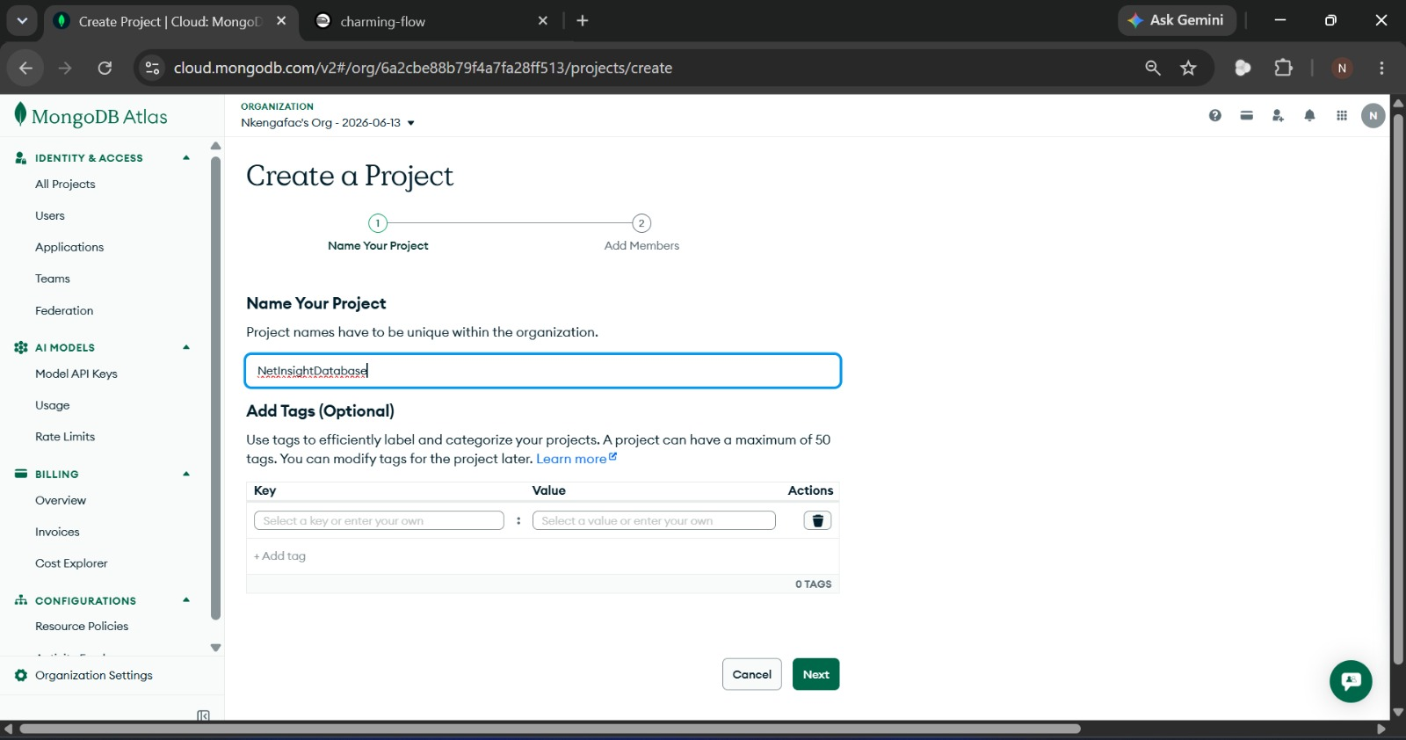
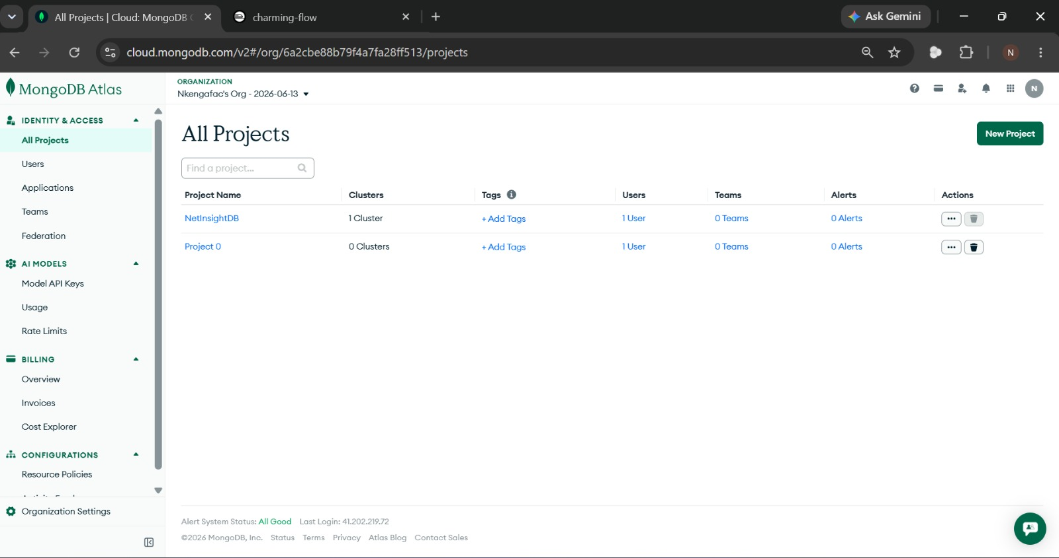
MongoDB Atlas configuration for NetInsight

Slide 11
Backend Implementation - Backend Technology Stack
Component | Technology
Runtime | Node.js
Web Framework | Express.js
ODM Library | Mongoose
CORS Handling | cors
Env Variables | dotenv
Database | MongoDB Atlas
Backend Hosting | Railway
Notes:
ODM:Object Document Mapper CORS: Cross-Origin Resource Sharing

Slide 12
API Endpoints
Network Metrics /api/network-metrics
POST
/api/network-metrics
201 Created
Save a single network measurement sample
GET
/api/network-metrics
200 OK
Return recent samples; filter by ?deviceId, ?limit (max 500)
GET
/api/network-metrics/stats
200 OK
Return today's aggregate averages via aggregation pipeline
Feedback /api/feedback
POST
/api/feedback
201 Created
Validate & save user feedback; 400 if fields invalid
GET
/api/feedback
200 OK
Return feedback most-recent-first; ?resolved filter, ?limit
PATCH
/api/feedback/:id
200 OK
Update resolved flag – allows admins to mark feedback as actioned
Notes:
HTTP request methods

Slide 13
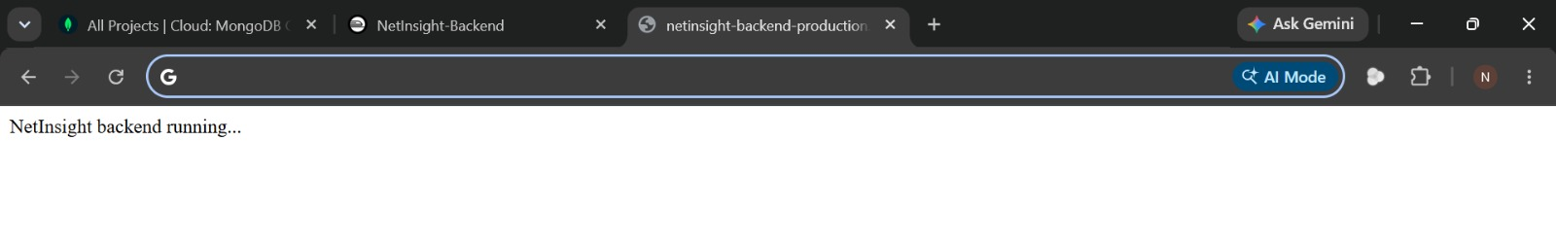
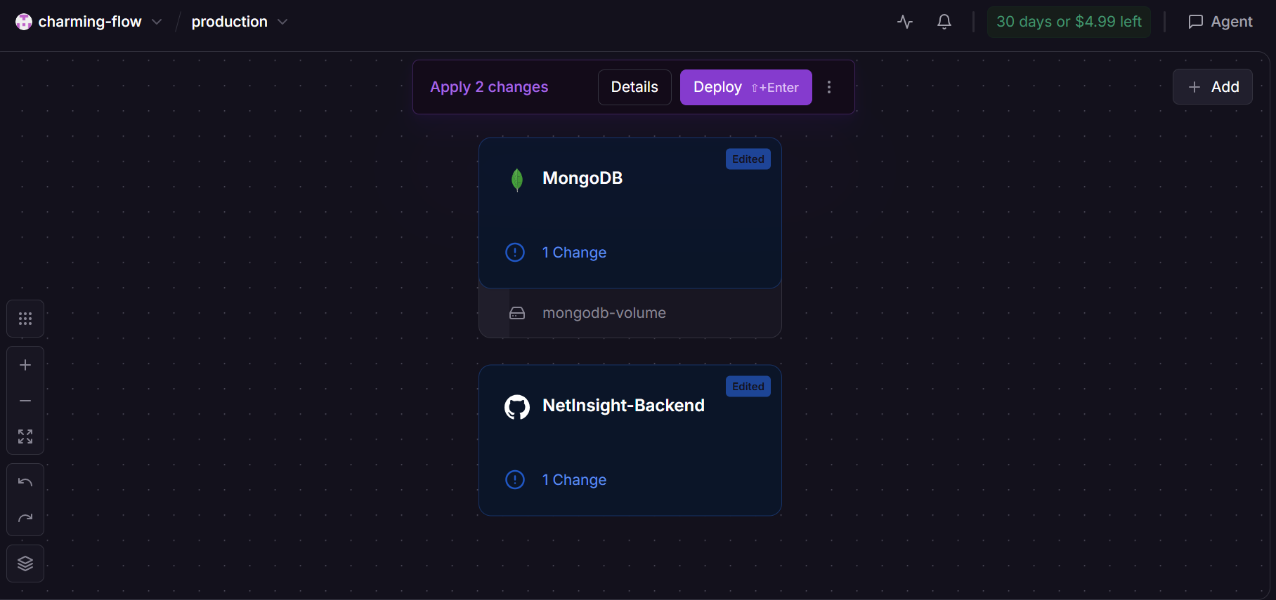
Testing API Endpoint with backend

Slide 14
DB ↔ Backend Connection - Connection Lifecycle & Security
1
Railway starts container
Security Measures
Runs `npm start` (node server.js)
Credentials in Env Vars
2
dotenv.config()
MONGODB_URI never committed to Git; stored in Railway's encrypted env store
Railway env vars available via process.env
TLS/SSL in Transit
3
connectDB() called
All Railway↔Atlas traffic over TLS via mongodb+srv:// protocol
Reads MONGODB_URI, calls mongoose.connect()
4
Mongoose opens TCP pool
IP Whitelisting
Uses mongodb+srv:// DNS seed list protocol
0.0.0.0/0 allowed (Railway free tier has no static IPs); would be restricted in production
5
Atlas authenticates
Resilient Failure
SCRAM-SHA-256 username/password auth
No process.exit() on DB failure – server stays up on transient errors
6
Server ready
CORS Middleware
Logs 'MongoDB connected' – accepts HTTP requests
cors package applied globally to allow any device IP to reach the Railway API

Slide 15
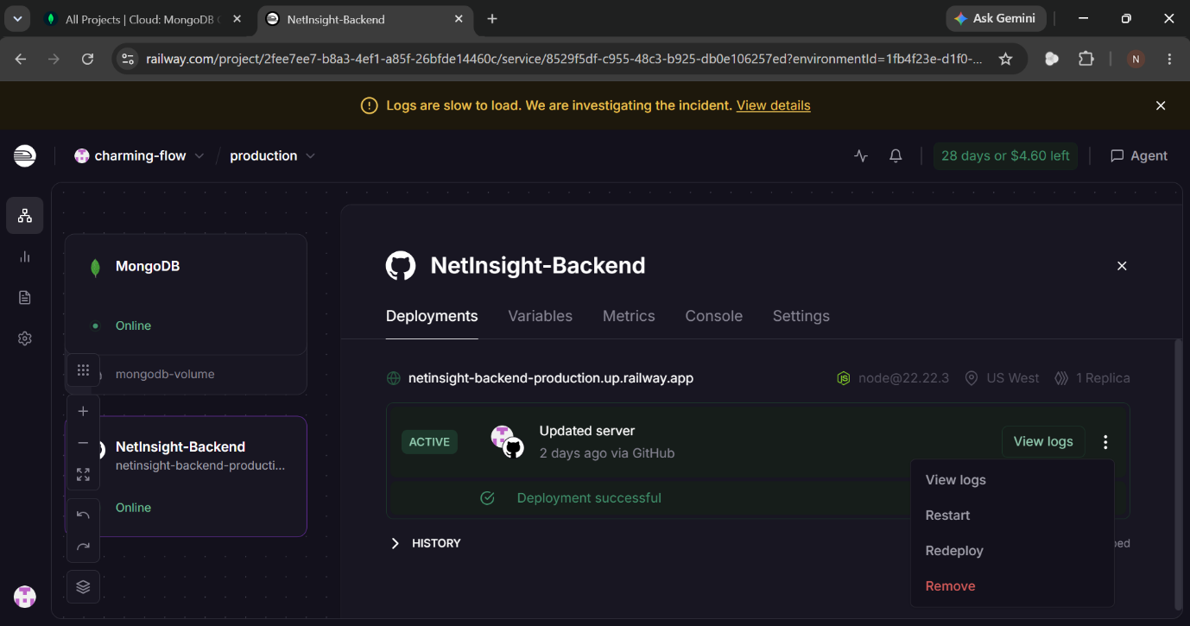

Slide 16
Connecting Backend to Frontend
React Native
(Expo App)
Railway
API (Express)
MongoDB
Atlas
How the Connection Was Made
1
Railway generated a public URL for the backend (netinsight-backend-production.up.railway.app).
Metrics screen calls POST /api/network-metrics to store measurement data every ~5 minutes.
4
2
Backend was tested via browser – /api/network-metrics/stats returned JSON correctly.
Dashboard calls GET /api/network-metrics/stats to fetch today's averages for display.
5
3
API_BASE_URL constant added to the React Native frontend, pointing to the Railway URL.
Feedback screen calls POST /api/feedback; success confirmed in MongoDB Atlas Data Explorer.
6

Slide 17
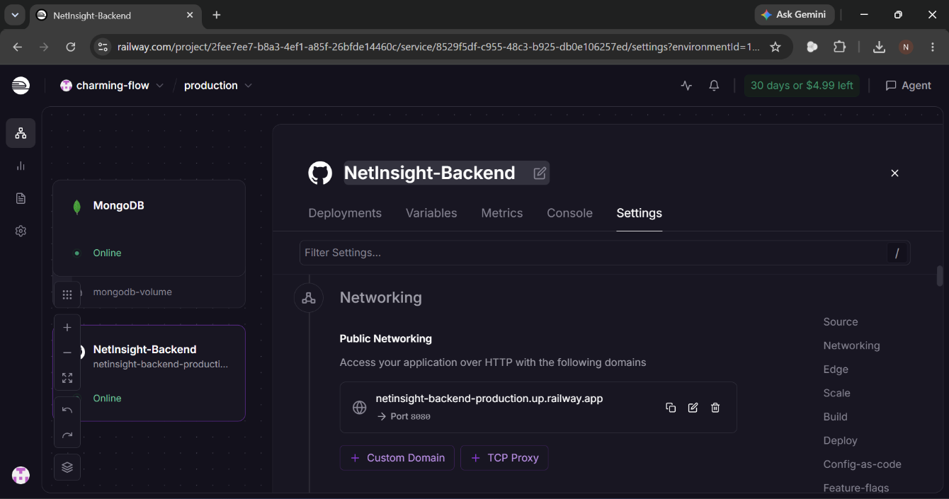

Slide 18
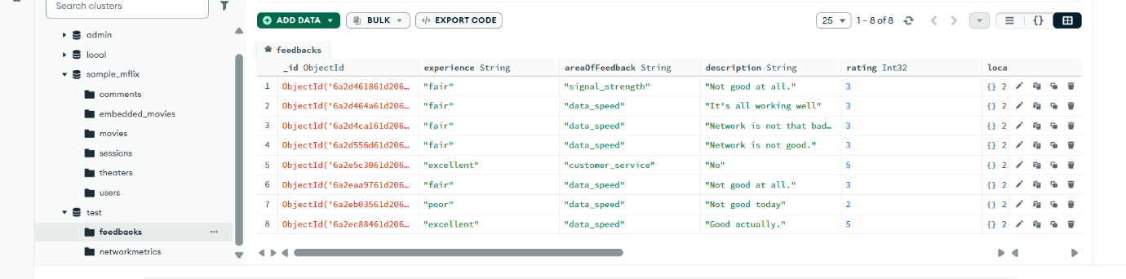
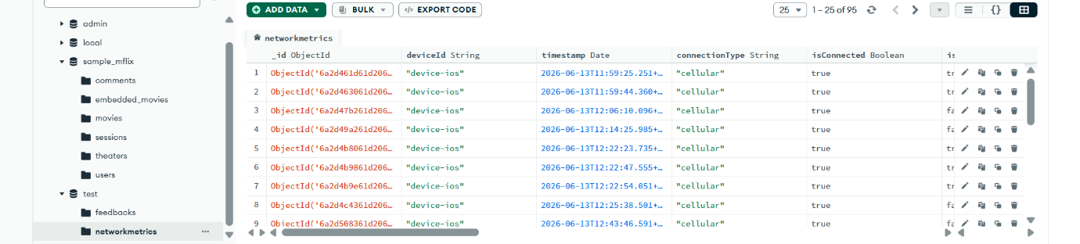

Slide 19
Conclusion
MongoDB Document Model
Schema flexibility & native geospatial support make it ideal for evolving QoE metrics.
Embedded Locations
Sub-documents avoid joins and match the NoSQL document model naturally.
Performance Indexes
Indexes on timestamp and deviceId ensure fast queries as data grows.
Secure by Design
Env-variable credentials, TLS transit, and CORS middleware protect the system.
Production-Ready Stack
Express + Mongoose + Railway + MongoDB Atlas delivers a fully managed cloud backend.

